Slide 1

Topic 1
Introduction to BackEnd Web Application Development and Getting Started with JavaScript

Slide 3

Introduction to Backend Web Application Development and Getting Started with JavaScript
Objectives
Describe the roles and interactions of foundational web technologies in creating interactive web applications.
Apply HTML, CSS and JavaScript to construct basic web pages with interactive elements.

Slide 4
Untangle the web
The Internet is the backbone of the Web, the technical infrastructure that makes the Web possible.
At its most basic, the Internet is a large network of computers that communicate together.

Slide 5
Client-server model

Slide 6
Client-server model
Clients are the typical web user's internet-connected devices (for example, your computer connected to your Wi-Fi, or your phone connected to your mobile network) and web-accessing software available on those devices (usually a web browser like Firefox or Chrome).
Servers are computers that store webpages, sites, or apps. When a client device wants to access a webpage, a copy of the webpage is downloaded from the server onto the client machine to be displayed in the user's web browser.

Slide 7
Backend web engineering
.
Backend web engineering refers to the development and maintenance of the server-side components of web applications.
Frontend web development focuses on what users see and interact with in their web browsers
Backend development involves working with servers, databases, and application logic that enable the frontend to function.

Slide 8
Foundational concepts in BackEnd Engineering
Communication protocols
TCP (Transmission Control Protocol) operates as a stream-based, connection-oriented protocol, prioritising reliable delivery but incurring connection setup and retransmission costs.
UDP (User Datagram Protocol) functions as a message-based, connectionless protocol, initiating faster but lacking guaranteed delivery.
Web server
Database engineering
Messaging systems
Security

Slide 9
HTML
HTML is a markup language which provides structure to the content published on the web. It contains elements which are used around content to make it look in a certain way.

Slide 10
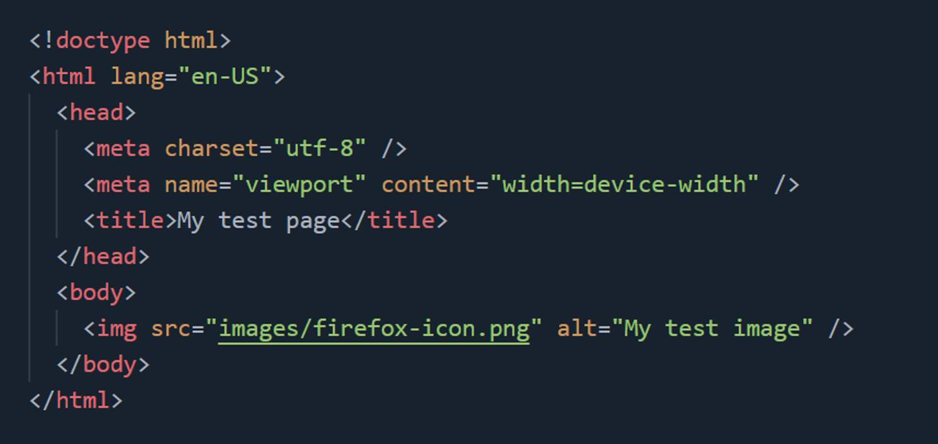
Anatomy of a HTML document

Slide 11
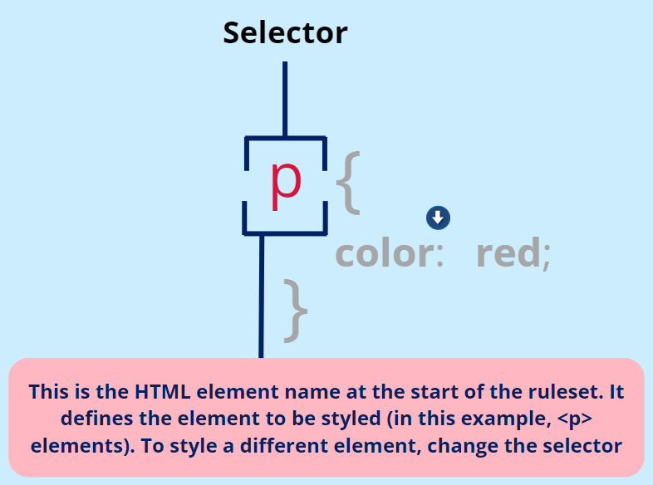
CSS
Like HTML, CSS is not a programming language. It's not a markup language either. CSS is a style sheet language. CSS is what you use to selectively style HTML elements.

Slide 12
JavaScript
JavaScript is a programming language that adds interactivity to your website.
JavaScript itself is relatively compact, yet very flexible.

Slide 13
End of Module Exercises
Please complete end of module exercises along with the module before the class.
Make sure you have access to the IATD Github Repository

Slide 14
Summary
Describe the roles and interactions of foundational web technologies in creating interactive web applications.
Apply HTML, CSS and JavaScript to construct basic web pages with interactive elements.

Slide 15

Introduction to Backend Web Application Development and Getting Started with JavaScript
Question & Answer

